Slide 1
Lecture 1 Dr. Suha K. Shihab
Materials Manufacturing
Manufacturing Processes
Casting Processes
Sand casting
Die casting
Centrifugal casting
Machining Processes
Turning
Milling
Drilling
Grinding
Primary and Secondary Forming Processes
Forging
Rolling
Drawing
Deep Drawing
Bending
Extrution
Joining Processes
Powder Metallurgy
References
Manufacturing Science , Ghosh and Mallik
Fundamentals of Modern Manufacturing, Mikell P. Groover
Processes and Materials of Manufacturing, ROY A. LINDBERG

Slide 2
Lecture 1 Dr. Suha K. Shihab
Introduction and Overview of Manufacturing
Manufacturing : manufacturing can be defined two ways one technologic and the other economic.
Technologically, manufacturing is the application of physical and chemical processes to alter the geometry and properties of a given starting material to make parts or products; manufacturing also includes assembly of multiple parts to make products. The processes to accomplish manufacturing involve a combination of machinery, tools, power, and labor as depicted in Figure 1 (a).
Economically, manufacturing is the transformation of materials into items of greater value by means of one or more processing and/or assembly operations, as depicted in Figure 1 (b).
FIGURE 1 Two ways to define manufacturing: (a) as a technical process, and (b) as an economic process.

Slide 3
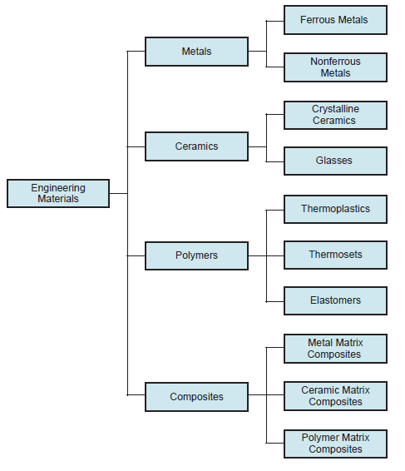
Lecture 1 Dr. Suha K. Shihab
Materials in Manufacturing
Most engineering materials can be classified into four basic categories:
metals,
ceramics,
polymers.
Composites
Their chemistries are different, their mechanical and physical properties are different, and these differences affect the manufacturing processes that can be used to produce products from them
Figure 2 Classification of the four engineering materials.

Slide 4
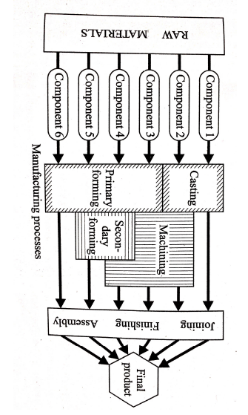
Lecture 1 Dr. Suha K. Shihab
Manufacturing Processes
The major processes a component undergoes before being converted into a final product are:
Casting
Primary and secondary forming
Machining
Joining

